Slide 1
Role of ODS in Real-Time
Data Warehousing
Prof. Navneet Goyal
Department of Computer Science & Information Systems
BITS, Pilani

Slide 2
RTDWH Lineage
Operational Data Source (ODS)
Motivations of the original ODS were similar to modern RTDWH
Implementation of RTDWH reflects a new generation of SW/HW & techniques

Slide 3
A Word About ODS
ODS is also referred to as Generation 1 DW
Separate system that sat between source transactional system & DW
Hot extract used for answering narrow range of urgent operational questions like:
  Was the order shipped?
  Was the payment made?
ODS is particularly useful when:
  ETL process of the main DW delayed the availability of data
  Only aggregated data is available

Slide 4
A Word About ODS
ODS plays a dual role:
  Serve as a source of data for DW
  Querying
Supports lower-latency reporting through creation of a distinct architectural construct & application separate from DW
Half operational & half DSS
A place where data was integrated & fed to a downstream DW
Extension of the DW ETL layer

Slide 5
A Word About ODS
ODS has been absorbed by the DW
  Modern DWs now routinely extract data on a daily basis
  Real-time techniques allow the DW to always be completely current
  DWs hav become far more operational than in the past
  Footprints of conventional DW & ODS now overlap so completely that it is not fruitful to make a distinction between the kinds of systems

Slide 6
A Word About ODS
Classification of ODS based on:
  Urgency
    Class I - IV
  Position in overall architecture
    Internal or External

Slide 7
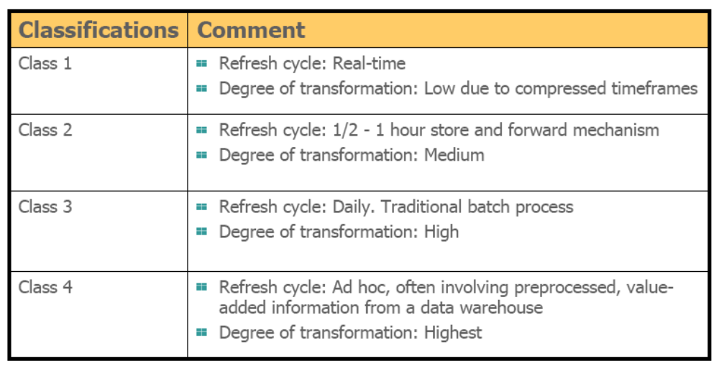
A Word About ODS

Slide 8
A Word About ODS
Urgency
  Class I – Updates of data from operational systems to ODS are synchronous
  Class II – Updates between operational environment & ODS occurs between 2-3 hour frame
  Class III – synchronization of updates occurs overnight

Slide 9
A Word About ODS
Urgency
  Class IV – Updates into the ODS from the DW are unscheduled
    Data in the DW is analyzed, and periodically placed in the ODS
    For Example –Customer Profile Data
    Customer Name & ID
    Customer Volume – High/low
    Customer Profitability – High/low
    Customer Freq. of activity – very freq./very infreq.
    Customer likes & dislikes

Slide 10
RTDWH
RTDWH advocates that instead of pulling operational data from OLTP system in nightly batch jobs into an ODS, data should be collected from OLTP systems as and when events occur move them directly into the data warehouse.
This enables the data warehouse to be updated instantaneously and removes the necessity of an ODS.

Slide 11
Concluding Remarks
If an ODS exists (Type 1), then it can contribute towards RTDWH
If it does not exist, then there is no point in building an ODS for either conventional DW or for RTDWH

